Slide 1
SLDS Coming Attractions
Data Collections Conference
August 2011
Presented by: Deb Holdren & Travis Allen
Notes:
Deb

Slide 2
Overview
Priorities
Operational Data Store (ODS)
Teacher Resource Links (TRL)
Assessments
Profile Manager
Enhancement Requests
New Systems in Tunnel
SLDS Projects Kick-Off
Notes:
Deb

Slide 3
Priorities
Adoption
Marketing
Policy Directives
RT3
Stabilize Production
Notes:
Deb

Slide 4
Priorities (continued)
Adoption
SLDS Needed for:
Common Core
Digital Resources for Teachers
IEP
Class Keys
Professional Development
Instructional Improvement
GAVS ……………………………..
Notes:
Deb

Slide 5
Priorities (continued)
SLDS Use is Low
Potential Users: 123,493
Actual Users:
Average Monthly Users 3,400 3%
1/29/2011 – 7/31/2011 16,984 14%
Notes:
Deb
Potential Users as of FTE 2011
Actual Users 1/29/2011 – 7/31/2011

Slide 6
Notes:
Deb

Slide 7
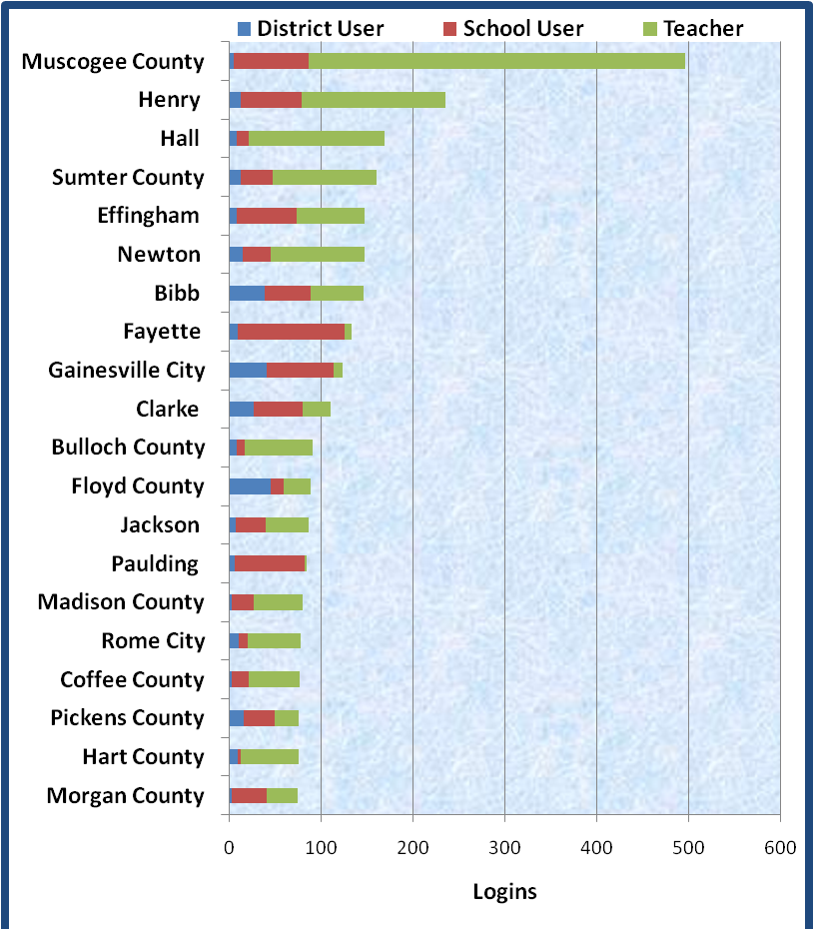
July’s Top 20 Districts
Notes:
Deb

Slide 8
Operational Data Store (ODS)
Objectives
Provide near real time data to Dashboards
Provide an opportunity to School districts to scrub data ahead of Formal Data Collection
Notes:
Travis

Slide 9
Operational Data Store (ODS)
Being Piloted
Effingham, Pike and Bleckley
Student Course Profile and Student Level (C01)
Working with vendors to solidify SPECS
Planning fully automated touch-free data transfer
Exit Pilot and move to General Availability
Notes:
Travis

Slide 10
Operational Data Store (ODS)
Evaluate Additional SR Layouts for inclusion
Will work with our Stakeholders to prioritize
Transport Benchmark tests
Other Data Exchange
Notes:
Travis

Slide 11
Teacher Resource Links (TRL)
Being Piloted in Jackson County
21st Century test visualization
K-8 ELA Resources
Resources aligned to GPS and will be aligned to Common Core
Student TAKE AWAY
Teacher TAKE AWAY
Notes:
Travis

Slide 12
Assessments
What’s Loaded
What’s Coming
CRCT 2012
Lets pull Kelli’s slides on Monday
Notes:
Travis

Slide 13
Profile Manager
Complete Profile Manager
Training Security Officers
Release Profile Manager to Production
Notes:
Travis

Slide 14
Enhancement Requests
Notes:
Travis

Slide 15
New Systems in Tunnel
GAVS
Georgia IEP Online
Financial Systems
Notes:
Deb

Slide 16
SLDS Projects to Kick-Off
Retrofit Apps to SLDS
Financial Systems
SLDS Data Exchange Within Georgia
SLDS Data Exchange Southeast Region
Drop-Out Recovery
Notes:
Deb

